Slide 1

JIMMA UNIVERSITY SPECIALIZED HOSPITAL
https://ugfacts.net/et/jimma-university-specialized-hospital/
Radiological Department
June 2022

Slide 2
RADIOLOGY STAFF at Jimma University Specialized Hospital
Worku Furi, MD. Radiologist. Radiology Chief
Merid Lema, MD. Radiologist
Elias Kedir, MD. Radiologist
Umer Ahimed, MD. Radiologist
Micheal Deyu, MD. Radiologist
Mesfin Zewudu, Medical Physist

Slide 3
EQUIPMENT
TECHNIQUE | IN ORDER | OUT OF ORDER
X-RAY | X
PORTATIL X-RAY | X
FLUOROSCOPY |  | X
ULTRASOUND 1 | 2 (lineal, curvex probes) | 1 (microconvex probe)
ULTRASOUND 2 | 2 (lineal, curvex probes)
MAMOGRAPHY |  | X
General Electric CT (64 slices) | X
Inyection bomb for CT (Angio-CT) |  | X
MRI (3Tesla) |  | X
Notes:
Ultrasound Probe Curvex Array Transducer

Slide 4
SESSIONS DR. MARTINEZ GIVE TO THE RESIDENTS
Pediatric Musculoskeletal cases, US and MRI (22.06.2022)
Pediatric Radiology Seminar, 1 (23.06.2022)
Pediatric Radiology Seminar, 2 (24.06.2022)
Radiology of the Pediatric Cerebellum for Radiologist (27.06.2022)
Histiocytosis, an Update (28.06.2022)
Intestinal Pediatric Obstruction (29.06.2022)
The Supraclavicular Space in the Pediatric Patient (30.06.2022)
Exams on Friday (01.07.2022)

Slide 5
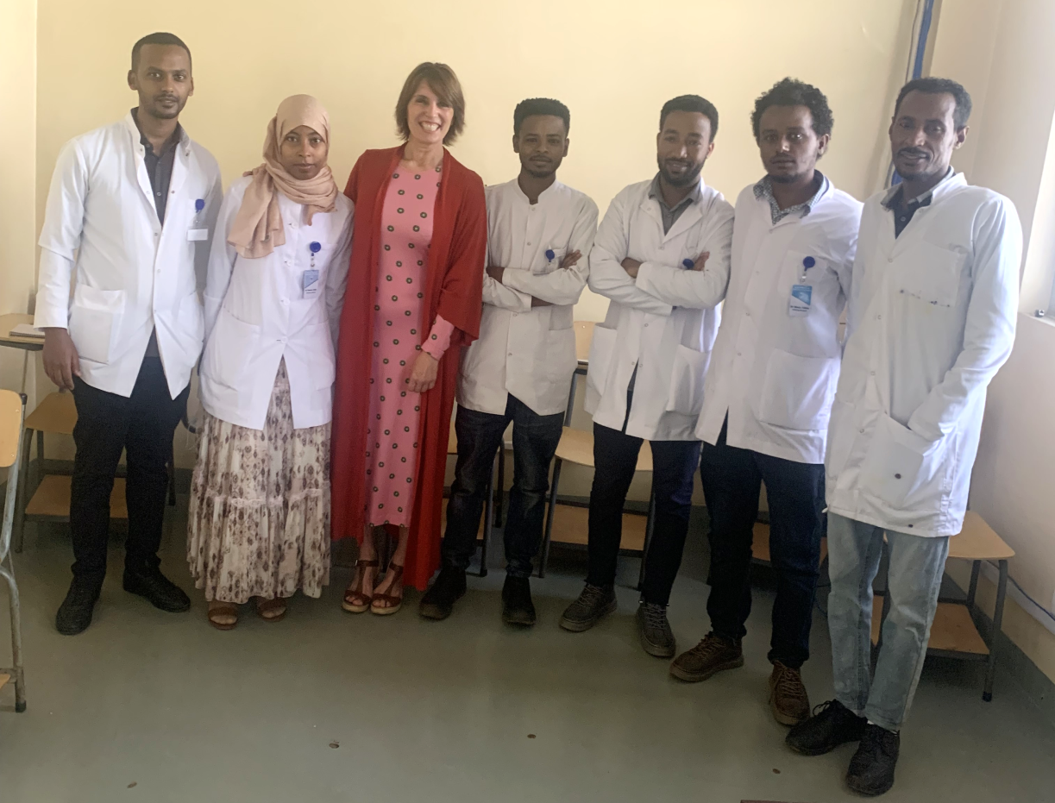
THE SIX RADIOLOGY RESIDENTS
Dr. Guta, Dra. Munira, Dra. Martínez, Dr. Tamirat, Dr. Biruk, Dr. Mesay, Dr. Mohamed

Slide 6
INTERESTING CASES SEEN IN THE RADIOLOGY DEPARTMENT over 2 weeks
Complicated chichenpox meningitis
Big occipital encephalocele in a newborn
Esophageal duplication cyst in a neonate
Bilateral acute hemorrhagic basal ganglia infarct
Left chronic thalamic infarct plus CMA acute infarct
Hydranencephaly
Congenital aqueductal stenosis
Encephalic death: symetric supratentorial extensive infarct
Gastro-esophagic adenocarcinoma
Extensive Crohn disease
Complete atelectasia of the left lung in a newborn
Fetal huge lumbar myelomeningocele
Multiple pyomiositys (TBC)
Lithopedium
Iliac family Ewing Sarcoma with metastasis
Myositis osificants of the thigh
Acute meningitis with secondary hydrocephalus
Huge Chondrosarcoma of the iliac bone
Neuroenteric cyst vs Hydatidic cyst, supratentorial
Nasopharingeal carcinoma in a 15 yo patient
Neonatal retroperitoneal big cyst (NB vs Lymphatic Malformation)
Aqueductal stenosis secundary to infection
Intracraneal Idiopathic Hypertension
Bilateral huge basal lung hydatic cysts
Ossifying Fibroma of the mandible
Lung carcinoid with bronquial extensión
Intestinal TBC
Retroperitonal lymphoma in a child
Right Wilms tumor
Maxilary Sinus Chondroblastoma
Intestinal obstruction secundary to bowel infection
Ventriculoperitoneal shunt with infection in thoracic segment
Brest cancer in axilary tail of the left mama
Bilateral hepatic hydatidic cyst in a child (solid phase)
Huge bilateral subdural hematoma in an old patient
Treated unilateral retinoblastoma (enucleation)
Cardiomegaly and bilateral lung edema
Milliary pulmonary TBC
Subdural bilateral hematoma in blood discrasia
...

Slide 7
VERY GOOD THINGS
The staff is very well trained, the radiological level is very good, they are scientific and they are prepared.
They get along well with each other, there is a very good atmosphere.
They work a lot, despite the fact that the schedule in Ethiopia is from 8:00 am to 12:00 pm, they work continuously, taking advantage of the time. In addition, they have to do extra weekend and afternoon shifts to be able to report all the studies. And the guards are localized but intense, they have to work.
The results of the tests are given in 72 hours, which implies that they cannot leave studies without informing, that they have to work a day. On the other hand, this means that it is difficult to delve into the study of interesting and difficult cases, but they talk to each other about these cases.
In the reports, the summary or conclusión part is very clear, it is very important because it gives a definitive idea and helps the specialist.
They have 6 residents for the first time in the service, this means that the level of teaching has to increase and, on the other hand, the residents are a stimulus.
One of the staff attends the three weekly sessions presented by the residents.
They have been really kind and welcoming to me.

Slide 8
THINGS THAT ARE AGAINST THEM
As I have shown in the table of the third slice, there is a lot of radiological equipment that does not work. For example, this hospital has the only MRI (magnetic resonance imaging) in all this part of the country that covers 20 million inhabitants, and it is out of service.
The PACS where the radiologists work is not large enough to store studies beyond three months, that is, the radiologist can not consult previous studies of the patients because they are deleted, which makes it very difficult to inform chronic patients, patients under follow-up, previous surgeries, etc.
They can not included the US (ultrasound) images in the PACS, it is really negative.
The program for working with the CT images is not update, then, they can not do correct reconstructions, and also they can not save key images.

Slide 9
THINGS FOR IMPROVEMENT
These are the four principal things:
The doctor-patient relationship needs to improve. There is a few relationship between the patient and the radiologist. Parents come with seriously ill children and the doctors does not tell them anything, also the parents do not ask. It is probably something cultural, but we are in a disease context and radiologist must know how to recognize the educational level of the patients and discuss with them the disease, comment on the prognosis and consequences, as well as the management of the pathology.
The cleanliness of ultrasound rooms needs improvement.
The staff is too stressed by the short of time and the large amount of work, in the public plus the private practice.
We have discussed among ourselves the need to reduce the radiation dose of CT scans. Avoid innecesary abdominal phases: Abdominal CT without and with multiphase contrast, do not perform CT without contrast to every patient, do not perform arterial, portal, and late phases in every patient, is needed to distinguish what each pathology requires. Similarly, reduce the FOV (field of view) of the studies: Brain CT excluding the neck, Abdominal CT excluding three parts of the thorax and upper part of the legs…

Slide 10
SUGGESTIONS
These points are suggestions:
I propose to hold sessions with the technicians to improve the way they perform CT scans.
Review the CT protocols with the technicians at the beginning of the morning and, depending on the pathology, record each type of study, to avoide unnecessary radiation and contrast.
There could be committees for difficult cases and for join diagnosis. I think that the most urgent would be with Internal Medicine, wich is the speciality that most often goes to radiology department to ask about cases.
The radiological staff should also give sessions to residents, and the staff should attend the sessions given that the radiology service has become a teaching specialty with the arrival of residents.
In relation to pediatric radiology, I suggest dedicating a weekly time to performing portable US in the Neonatal hospitalary area and in the Pediatric Intensive Care unit. Pediatricians have a portable ultrasound machine with very good resolution, with specific pediatric probes for transfontanellar and abdominal US, which can be used for hospitalized pediatric patients (neonates and non neonates) and in the critical unit.

Slide 11
WHAT HAVE I CONTRIBUTED TO THE RADIOLOGY UNIT
Morning sessions to the residents every day at 2.30h local time.
A computer file with pediatric sessions (more than 100) and pediatric radiological bibliography.
A day with the technitians working with them in the use of radiation and pediatric protocols in CT.
Two days in Neontal Unit and Intensive Care Pediatric Unit doing transfontanellar and pediatric abdominal US, helping and talking with the Pediatricians.
Discussion of the cases everyday with the medical radiology staff.
I give the password to the medical staff and to the residents for two very used radiological web pages (IMAIOS and RSNA Journal)
I have invited de residents to attend the next Pediatric National Radiological Curse that is celebrated by my radiological department in January 2023 in Málaga. For this six residents this course will be free.
I am goint to send then monthly pediatric radiological cases.
I have talked with the head of the Pediatric Critical Care Unit and with the head of the Pediatric Neonatal Unit about the pediatric radiology and we will in contact. I have sent them a pediatric chest X-ray reading tutorial.
Finally, the head of Radiology and I had a meeting on the last day about all the topics discussed.

Slide 12
I have to thank the Radiodiology Team at Jimma University Specialized Hospital for their constant work, their dedication, and the warm welcome with which they have received me.
A respectful greating to all.
María Isabel Martínez León, MD, PhD. maria.i.martinez.leon@gmail.com

